Slide 1
Biblioetec
Projeto de TCC

Slide 2
Integrantes
Gabriel Bassani da Silva
Glauber Henrique Rodrigues
Guilherme Dias Ferreira
Gustavo de Oliveira Tomaz
João Pedro Gregório dos Santos
Vinícius Neves Faria

Slide 3
Súmario
04
Ferramentas utilizadas
01
Introdução
02
Ideia do site
05
Design
06
07
03
Funcionamento do site
Linguagens utilizadas
Conclusão
Notes:
Note: you can add between 3 and 6 sections, the structure can vary. The numbers have to be kept

Slide 4
01
Introdução

Slide 5
02
Ideia do site

Slide 6
03
Linguagens utilizadas

Slide 7



Linguagens utilizadas
HTML
CSS
JavaScrpit
HTML é uma linguagem de marcação utilizada na construção de páginas na Web. Documentos HTML podem ser interpretados por navegadores.
Cascading Style Sheets é um mecanismo para adicionar estilos a uma página web, aplicado diretamente nas tags HTML ou ficar contido dentro das tags <style>.
JavaScript é uma linguagem de programação interpretada estruturada, de script em alto nível com tipagem dinâmica fraca e multiparadigma.

Slide 8



Linguagens utilizadas
PHP
SQL
Sass
PHP é uma linguagem interpretada livre, usada originalmente apenas para o desenvolvimento de aplicações presentes e atuantes no lado do servidor, capazes de gerar conteúdo dinâmico na World Wide Web.
É uma linguagem de domínio específico desenvolvida para gerenciar dados relacionais em um sistema de gerenciamento de banco de dados.
Sass é uma linguagem de folhas de estilo concebida inicialmente por Hampton Catlin e desenvolvida por Natalie Weizenbaum.

Slide 9
04
Ferramentas utilizadas

Slide 10



Ferramentas utilizadas
Visual Studio Code
XAMPP
Bootstrap
O Visual Studio Code é um editor de código-fonte desenvolvido pela Microsoft para Windows, Linux e macOS. Ele inclui suporte para depuração, controle de versionamento Git incorporado
XAMPP é um pacote com os principais servidores de código aberto do mercado, incluindo FTP, banco de dados MySQL e Apache com suporte as linguagens PHP e Perl.
Bootstrap é um framework web com código-fonte aberto para desenvolvimento de componentes de interface e front-end para sites e aplicações web, usando HTML, CSS e JavaScript.

Slide 11


Ferramentas utilizadas
Hostinger
MySQL
Hostinger International, Ltd é um provedor de Hospedagem Web de propriedade de funcionários e registrador de domínio na Internet, estabelecido em 2004.
O MySQL é um sistema de gerenciamento de banco de dados, que utiliza a linguagem SQL como interface.

Slide 12
04
Design

Slide 13
05
Funcionamento

Slide 14
06
Conclusão

Slide 15
01
History
You can enter a subtitle here if you need it

Slide 16
First bookstores
2004
2600 a.c
Mercury is the closest planet to the Sun and the smallest one in the Solar System—it’s only a bit larger
Venus has a beautiful name and is the second planet from the Sun. It’s hot and has a poisonous atmosphere

Slide 17
First bookstores
2004
2600 a.c.
Mercury is the closest planet to the Sun and the smallest one in the Solar System—it’s only a bit larger
Venus has a beautiful name and is the second planet from the Sun. It’s hot and has a poisonous atmosphere

Slide 18
Better benefits and salaries
Salaries
Benefits
Support
Mercury is the closest planet to the Sun and the smallest of them all
Venus has a beautiful name and is the second planet from the Sun
Despite being red, Mars is actually a cold place. It’s full of iron oxide dust

Slide 19
Better benefits and salaries
Salaries
Support
Benefits
Mercury is the closest planet to the Sun and the smallest of them all
Despite being red, Mars is actually a cold place. It’s full of iron oxide dust
Venus has a beautiful name and is the second planet from the Sun

Slide 20
02
Celebrate
You can enter a subtitle here if you need it

Slide 21
Types of libraries
National
Publish
Children’s
Specialized
Mars is actually a very cold place
Venus has extremely high temperatures
Jupiter is the biggest planet of them all
Saturn is a gas giant and has several rings

Slide 22
Types of libraries
National
Publications
Children’s
Specialized
Mars is actually a very cold place
Venus has extremely high temperatures
Jupiter is the biggest planet of them all
Saturn is a gas giant and has several rings

Slide 23
Awesome words

Slide 24
Awesome words

Slide 25
—Someone Famous
“This is a quote. Words full of wisdom that someone important said and can make the reader get inspired.”

Slide 26

A picture always reinforces
the concept
Images reveal large amounts of data, so remember: use an image instead of a long text. Your audience will appreciate it

Slide 27

A picture always reinforces
the concept
Images reveal large amounts of data, so remember: use an image instead of a long text. Your audience will appreciate it

Slide 28

A picture always reinforces
the concept
Images reveal large amounts of data, so remember: use an image instead of a long text. Your audience will appreciate it

Slide 29
April 12
National library workers day

Slide 30
April 12
National library workers day

Slide 31
24h 37m 23s
333,000
386,000 km
Jupiter's rotation period
Earths would fit in the Sun’s mass
Distance between Earth and the Moon

Slide 32
Some library percentages
75%
Worker 1
50%
Worker 2
Mercury is the closest planet to the Sun and the smallest of them all
Despite being red, Mars is a very cold planet full of iron oxide dust

Slide 33
Some library percentages
75%
Worker 1
Mercury is the closest planet to the Sun and the smallest of them all
50%
Worker 2
Despite being red, Mars is a very cold planet full of iron oxide dust

Slide 34
Literature periods
1837-1901
1901-1910
1914-1939
1939-present
Victorian
Edwardian
Modern
Postmodern
Mercury is a very small planet
Venus has extremely high temperatures
Saturn is the only planet with rings
Venus has extremely high temperatures

Slide 35
Literature periods
1837-1901
1901-1910
1914-1939
1939-present
Victorian
Edwardian
Modern
Postmodern
Mercury is a very small planet
Venus has extremely high temperatures
Saturn is the only planet with rings
Venus has extremely high temperatures

Slide 36
Literature periods
1837-1901 | Victorian | Mercury is the closest planet to the Sun
1901-1910 | Edwardian | Venus has extremely high temperatures
1914-1939 | Modern | Saturn is the only planet with rings
1939-present | Postmodern | Venus has extremely high temperatures

Slide 37



Best workers
Angelina M
Rousse P
Lauren V
Venus has a beautiful name and is the second planet from the Sun. It’s terribly hot, even hotter than Mercury, and its atmosphere is extremely poisonous. It’s the second-brightest natural object in the night sky after the Moon

Slide 38



Best workers
Angelina M
Rousse P
Alan F
Mercury is the closest planet to the Sun and the smallest of them all
Despite being red, Mars is actually a cold place. It’s full of iron oxide dust
Venus has a beautiful name and is the second planet from the Sun

Slide 39
Best worker of the month
Name | Alan F
Occupation | Bookstore manager
What people think about him | Mercury is the closest planet to the Sun
Hobbies | Books, music, art, friends and party
Venus has a beautiful name and is the second planet from the Sun. It’s terribly hot, even hotter than Mercury, and its atmosphere is extremely poisonous

Slide 40
Our bookstores
Bookstore 1
Venus has extremely high temperatures
Bookstore 2
Mars is actually a very cold place
Bookstore 3
Saturn is the only planet with rings
Bookstore 4
Mercury is the closest planet to the Sun

Slide 41
Our bookstores
Bookstore 1
Bookstore 3
Venus has extremely high temperatures
Saturn is a gas giant and has several rings
Bookstore 2
Bookstore 4
Despite being red, Mars is actually a cold place
Mercury is the closest planet to the Sun

Slide 42
A timeline always works fine
1862
1960
2000
Venus has extremely high temperatures
Jupiter is the biggest planet of them all
Neptune is very far from the Sun
1914
1887
1984
Mercury is a very small planet
Mars is actually a very cold place
Saturn is composed of hydrogen

Slide 43
Literature movements
The lost
Postmodernism
Mars is actually a very cold place
Venus has extremely high temperatures
The beat
Concrete poetry
Jupiter is the biggest planet of them all
Saturn is a gas giant and has several rings

Slide 44
Literature movements
The lost
Postmodernism
Despite being red, Mars is actually a cold place
Venus has extremely high temperatures
The beat
Concrete poetry
Jupiter is the biggest planet of them all
Saturn is a gas giant and has several rings

Slide 45
Literature movements
The lost
Postmodernism
Despite being red, Mars is actually a cold place
Venus has extremely high temperatures
The beat
Concrete poetry
Jupiter is the biggest planet of them all
Saturn is a gas giant and has several rings

Slide 46
Cataloging of books
 | Hall 1 | Hall 2 | Hall 3
Generalities | 152 | 454 | 14
Philosophy | 265 | 22 | 254
Religions | 658 | 45 | 778
Social sciences | 220 | 254 | 245
Pure sciences | 69 | 36 | 74
Fine arts | 300 | 11 | 21

Slide 47
Writing workshop october
Introduction
Mon | Tue | Wed | Thu | Fri | Sat | Sun
 |  |  |  |  | 1 | 2
3 | 4 | 5 | 6 | 7 | 8 | 9
10 | 11 | 12 | 13 | 14 | 15 | 16
17 | 18 | 19 | 20 | 21 | 22 | 23
24 | 25 | 26 | 27 | 28 | 29 | 30
31
Mercury is a smallest planet
Creativity
Venus is a hot planet
Narrative
Earth is the planet with life
Final project
Mars was named after a god

Slide 48
Most commented novels
Shooting in Marrakech
Living up the streets
The girl and the doctor
Mercury is the closest planet to the Sun and the smallest of them all
Venus has a beautiful name and is the second planet from the Sun
Despite being red, Mars is actually a cold place. It’s full of iron oxide dust

Slide 49
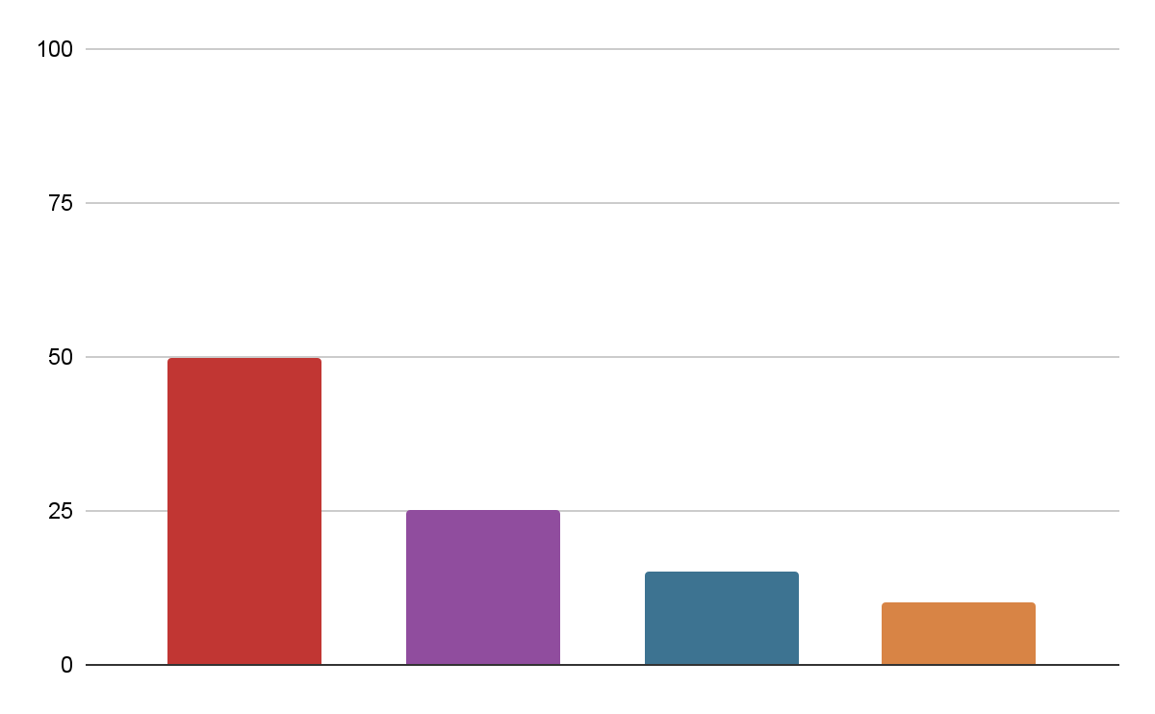
Most read categories
Category A
50%
Venus has extremely high temperatures
Category B
25%
Mars is actually a very cold place
Category C
15%
Saturn is a gas giant and has several rings
Category D
10%
Jupiter is the biggest planet of them all
Follow the link in the graph to modify its data and then paste the new one here. For more info, click here
Notes:
El gráfico de tiene que estar hecho por Google Sheets. Hay que incluir una leyenda para que el usuario pueda incluir información de la gráfica

Slide 50
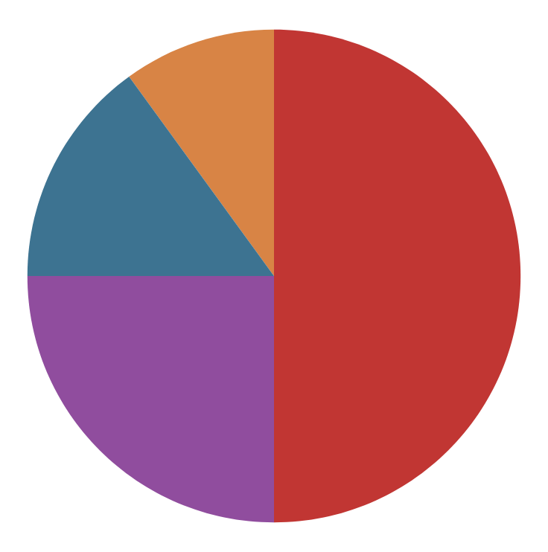
Most read categories
Category D
10%
50%
Category A
Jupiter doesn’t have a solid surface
Venus has extremely high temperatures
Category C
15%
25%
Category B
Saturn was named after a Roman god
Earth is the planet where we all live on
Follow the link in the graph to modify its data and then paste the new one here. For more info, click here
Notes:
El gráfico de tiene que estar hecho por Google Sheets. Hay que incluir una leyenda para que el usuario pueda incluir información de la gráfica

Slide 51
Our team
Medieval | Renaissance | Neoclassical
Content: Mars is actually a very cold place Venus has extremely high temperatures | Content: Neptune is the farthest planet from the Sun Mercury is the closest planet to the Sun | Content: Earth is the third planet from the Sun Despite being red, Mars is actually a cold place
Effect: Jupiter is the biggest planet of them all Saturn is composed of hydrogen and helium | Effect: The Moon is Earth’s natural satellite The Sun’s is at the center of the Solar System | Effect: Pluto is now considered a dwarf planet Ceres is located in the main asteroid belt

Slide 52


Our team
Chris Dean
Venus Rill
You can talk a bit about this person here
You can talk a bit about this person here

Slide 53


Our team
Venus Rill
Chris Dean
You can talk a bit about this person here
You can talk a bit about this person here

Slide 54
Obrigado!
Alguma dúvida?
Please keep this slide for attribution

